Slide 1
Investigating the Association Between Cardiovascular Health Indicators and Individual Characteristics
By Weiyi Huang, Aaron Niecestro, Yuzhou Pan, Alison Stephens
Notes:
Hello, my name is Alison Stephens. (Everyone introduce themselves).

Slide 2
Introduction

Slide 3
Scientific Questions and Motivation
Scientific Questions:
  How do age, gender, and BMI categories jointly predict cardiovascular and metabolic health indicators (pulse rate, blood pressure, and glucose levels)?
  How do certain health factors (age, gender, hypertension status, BMI categories) respectively and simultaneously influence vital signs and glucose regulation?
By identifying key factors that contribute to health risk(s) at an individual level, healthcare providers can tailor prevention and treatment plans more accurately.
When multiple factors are studied together, researchers can control for confounding variables and obtain more precise conclusions about what truly influences cardiovascular health and glucose regulation.
Notes:
Our scientific question was “1st question”. We are also interested in “second question”
First question answers the main predictors
Second question answer the main + potential predictors

Slide 4
Description of the Data
This dataset provides comprehensive information on 5,437 patients, including 14 independent attributes such as demographics, clinical parameters, and medical history.
The data was collected by researchers from United International University and Southeast University in Bangladesh.
The data was cleaned so only adult participants were analyzed with the following rules:
  15 ≤ BMI ≤ 55 (Normal BMI numbers for adults, especially considering individual height and weight)
  Pulse Rate ≥ 40 (Minimum was a normal pulse rate for an Athlete)
  Systolic BP ≤ 210 (Non-medical emergency, anything above counts as medical emergency)
  Glucose ≥ 4.0 & glucose ≤ 13.3 (Non-medical emergency)
Notes:
The features include age, gender, pulse rate, blood pressure (systolic and diastolic), glucose level, BMI, and family history of diabetes and related conditions like hypertension and cardiovascular disease
However, the specific methods employed for data collection—such as whether it was gathered through surveys, medical records, or other means—are not detailed in the dataset description.

Slide 5
Baseline Characteristics
 | Original Data
Variable | Mean | Standard Deviation
Pulse Rate (bpm) | 76.49 | 12.02
Glucose (mg/dL or mmol/L) | 7.123 | 1.64
Systolic Blood Pressure (mmHg) | 133.4 | 21.92
Diastolic Blood Pressure (mmHg) | 81.89 | 12.44
Age (Years) | 45.33 | 14.13
Variable | Count (n = 5046)
Gender: Male | 1486
Gender: Female | 3560
Hypertension: Yes | 516
Hypertension: No | 4530
Underweight (15 ≤ BMI < 18.5) | 722
Healthy (18.5 ≤ BMI < 25) | 3276
Overweight (25 ≤ BMI < 30) | 827
Obese (30 ≤ BMI ≤ 55) | 221
Notes:
Most of the means are approximately normal but with high standard deviations.
For our sample counts, male was slightly smaller than female. No hypertension was significantly larger. Healthy was significantly larger than the other BMI.

Slide 6
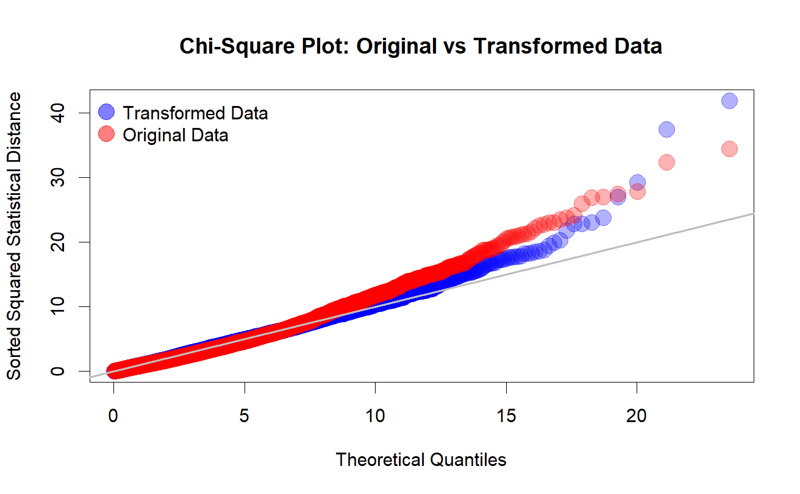

Slide 7
Transformation of the data
 | Transformation Data
Variable | Mean | Standard Deviation
Pulse Rate (bpm) | 6.34 | 0.31
Glucose (mg/dL or mmol/L) | 1.18 | 0.07
Systolic Blood Pressure (mmHg) | 1.60 | 0.01
Diastolic Blood Pressure (mmHg) | 4.69 | 0.17
Using R Box-cox powered transformed function to transform the response variables so our data looks more normally distributed
  Pulse Rate λ ≈ 0.167
  Glucose λ ≈ -0.562
  Systolic Blood Pressure (SBP) λ ≈ -0.589
  Diastolic Blood Pressure (DBP) λ ≈ 0.029
Notes:
We did not transform age

Slide 8
Methods
Notes:
Alison gets first 7 slides, stops here, Aaron starts here

Slide 9
Statistical Methods used for Analysis
One Sample Hotelling T² Test
  To test whether the average vector of health measurements (pulse rate, SBP, DBP, glucose) differs significantly from a known or hypothesized population mean vector.
One-Way & Two-Way MANOVA
  To test if the multivariate means of the health measurements differ across groups defined by one factor (One-Way, e.g., BMI category) or two factors (Two-Way, e.g., Gender × Hypertensive status), considering the dependent variables together.
Multivariate Linear Regression
  To model the relationship between multiple continuous dependent variables (pulse rate, SBP, DBP, glucose) and multiple predictors (age, gender, hypertensive status, BMI category), and determine if the predictors significantly explain variation in the health outcomes.
Notes:
Aaron starts here

Slide 10
Statistical Methods used for Analysis
4. MANCOVA
  To compare group differences on the health measurements while controlling for continuous covariates, like age.
5. Post-Hoc Analysis Confidence Intervals
  After a significant One-Way & Two-Way MANOVA or MANCOVA, to pinpoint which specific groups differ on which specific dependent variables, and to estimate the size and direction of these differences with confidence intervals.

Slide 11
Statistical Analysis

Slide 12
Response and Predictors
Response Variables:
Pulse Rate
Glucose
Systolic Blood Pressure
Diastolic Blood Pressure
Key Predictors:
Age
Gender (Male/Female)
BMI Categories (Underweight, Healthy, Overweight, Obese)
Potential Predictor:
Hypertensive (Yes/No)
Notes:
Key predictors are the predictors we would keep in the model regardless whether they were significant
Predictors references:
females was reference group for gender
Healthy was the reference group for BMI categories
No hypertension was the reference group for hypertensive
Potential Predictor is the one that could be removed if not significant

Slide 13
One Sample Hotelling T² Test
Tested each of the continuous variables individually to see if the sample means matched the hypothesis test
Also tested a response variable vector consisting of (pulse rate, SBP, DBP, glucose) with different means and a vector of (pulse rate, SBP, DBP, glucose, age)
i.e. H₀: μ₀ = 6, 2, 5, 1, 45, H₁: μ₀ ≠ 6, 2, 5, 1, 45
  Conclusion: Reject the null hypothesis

Slide 14
Variable | T² Confidence Intervals: | Bonferroni-Corrected Confidence Intervals:
Transformed Pulse Rate | [6.325, 6.355] | [6.328, 6.351]
Transformed SBP | [1.601, 1.601] | [1.601, 1.601]
Transformed DBP | [4.679, 4.695] | [4.681, 4.693]
Transformed Glucose | [1.173, 1.80] | [1.174, 1.179]
Age | [44.665, 45.990] | [44.815, 45.840]

Slide 15
One-Way MANOVA
Response Variables vs BMI Categories
  Conclusion: Reject the null hypothesis.
Response Variables vs Gender Categories
  Conclusion: Reject the null hypothesis.
Response Variables vs Hypertension Categories
  Conclusion: Reject the null hypothesis.

Slide 16
One-Way MANOVA CIs for BMI Categories
 | Pulse Rate | Systolic BP | Diastolic BP | Glucose
Healthy vs Obese | (-0.1203, 0.0379) | (-0.0066, -0.0023) | (-0.1533, -0.0709) | (-0.0173, 0.0185)
Healthy vs Overweight | (-0.0822, 0.0064) | (-0.0035, -0.0011) | (-0.0910, -0.0448) | (-0.0179, 0.0022)
Healthy vs Underweight | (-0.0549, 0.0387) | (-0.0006, 0.0020) | (0.0122, 0.0610) | (-0.0103, 0.0108)
Obese vs Overweight | (-0.0830, 0.0894) | (-0.0002, 0.0045) | (-0.0007, 0.0891) | (-0.0280, 0.0110)
Obese vs Underweight | (-0.0544, 0.1206) | (0.0027, 0.0075) | (0.1031, 0.1943) | (-0.0202, 0.0194)
Overweight vs Underweight | (-0.0281, 0.0879) | (0.0013, 0.0046) | (0.0743, 0.1347) | (-0.0050, 0.0212)
Notes:
Aaron stops here

Slide 17
Two-Way MANOVA
Response Variables vs Gender + BMI Categories
  BMI category is a strong predictor of blood pressure levels, while gender is strong for pulse rate
Response Variables vs Gender + Hypertensive
  Gender significantly affects pulse rate and diastolic blood pressure, while hypertensive is strong overall predictor
Response Variables vs BMI Categories + Hypertensive
  Hypertension status is strongly associated with higher blood pressure and glucose, supporting known clinical patterns while BMI is a significant predictor, especially for blood pressure
Response Variables vs Interaction effect of Gender*BMI
  There are no significant differences within gender across BMI categories
Response Variables vs Interaction effect of Hypertensive*Gender
  There are no significant differences within hypertensive across BMI categories
Notes:
Yuzhou starts here

Slide 18
Two-Way MANOVA CI for BMI and Gender
 | Pulse Rate | Systolic BP | Diastolic BP | Glucose
Healthy vs Obese | (-0.035, 0.0217) | (-0.1086, -0.0501) | (-0.1253, -0.0709) | (-0.0437, 0.0371)
Healthy vs Overweight | (-0.0303, 0.0014) | (-0.057, -0.0243) | (-0.0748, -0.0444) | (-0.0474, -0.0023)
Healthy vs Underweight | (-0.0225, 0.011) | (-0.007, 0.0275) | (0.0162, 0.0482) | (-0.023, 0.0245)
Obese vs Overweight | (-0.0387, 0.023) | (0.007, 0.0705) | (0.0089, 0.0681) | (-0.0654, 0.0224)
Obese vs Underweight | (-0.0305, 0.0322) | (0.0573, 0.122) | (0.1002, 0.1604) | (-0.0406, 0.0487)
Male vs Female | (0.0573, 0.076) | (-0.0172, 0.0021) | (-0.0066, 0.0114) | (-0.0185, 0.0081)

Slide 19
MANCOVA
Tested for
  Age + BMI Categories
    Age does indeed affect the BMI categorical level confidence intervals
  Age + Gender
    Age does indeed affect the Male vs Female confidence intervals
  Age + Hypertensive
    Age does indeed affect the Hypertension vs No Hypertension confidence intervals

Slide 20
MANCOVA 95% Confidence Intervals
 | Pulse Rate | Systolic BP | Diastolic BP | Glucose
Healthy vs Obese | (-0.0415, 0.0154) | (-0.1215, -0.0676) | (-0.1315, -0.0778) | (-0.0511, 0.0285)
Healthy vs Overweight | (-0.0306, 0.0013) | (-0.0643, -0.0341) | (-0.078, -0.048) | (-0.0517, -0.0071)
Healthy vs Underweight | (-0.0298, 0.0041) | (0.015, 0.047) | (0.0239, 0.0558) | (-0.0117, 0.0357)
Obese vs Overweight | (-0.0325, 0.0294) | (0.016, 0.0747) | (0.0124, 0.0708) | (-0.0614, 0.0252)
Obese vs Underweight | (-0.0314, 0.0318) | (0.0956, 0.1555) | (0.1147, 0.1743) | (-0.0209, 0.0676)
Overweight vs Underweight | (-0.019, 0.0228) | (0.0603, 0.1001) | (0.083, 0.1227) | (0.012, 0.0708)
Male vs Female | (0.048, 0.067) | (0.0182, 0.0367) | (0.0096, 0.0283) | (-0.0011, 0.0259)
Hypertensive vs Not | (0.0125, 0.0415) | (-0.1582, -0.1314) | (-0.1427, -0.1155) | (-0.0317, 0.0089)
Notes:
Red: change direction of effect: used to contain 0 (not significant), now not containing 0 (signif.), after controlling for age

Slide 21
Multivariate Linear Regression
Main Predictor Model
  Transformed (Pulse Rate, SBP, DBP, Glucose) ~ Age + Gender + BMI Categories
  AIC = -108904.5 df = 6
All Predictor Model (Final Chosen Model)
  Transformed (Pulse Rate, SBP, DBP, Glucose) ~ Age + Gender + Hypertensive + BMI Categories
  AIC = -109271 df = 7
Reduced-Full Model Test: all predictor model (full) vs. main predictor model (reduced)
  Wilk’s Lambda: 0.92774, p-value < 0.001

Slide 22
Final Chosen Model
Variable | Test Statistic (Wilk’s Lambda) | P-Value | Significant?
Age | 0.8375 | < 0.001 | Yes
Gender (Male/Female) | 0.9627 | < 0.001 | Yes
Hypertensive (Yes/No) | 0.9243 | < 0.001 | Yes
BMI (Obese/ Healthy/ Overweight/ Underweight) | 0.9509 | < 0.001 | Yes
Notes:
State results from SAS

Slide 23
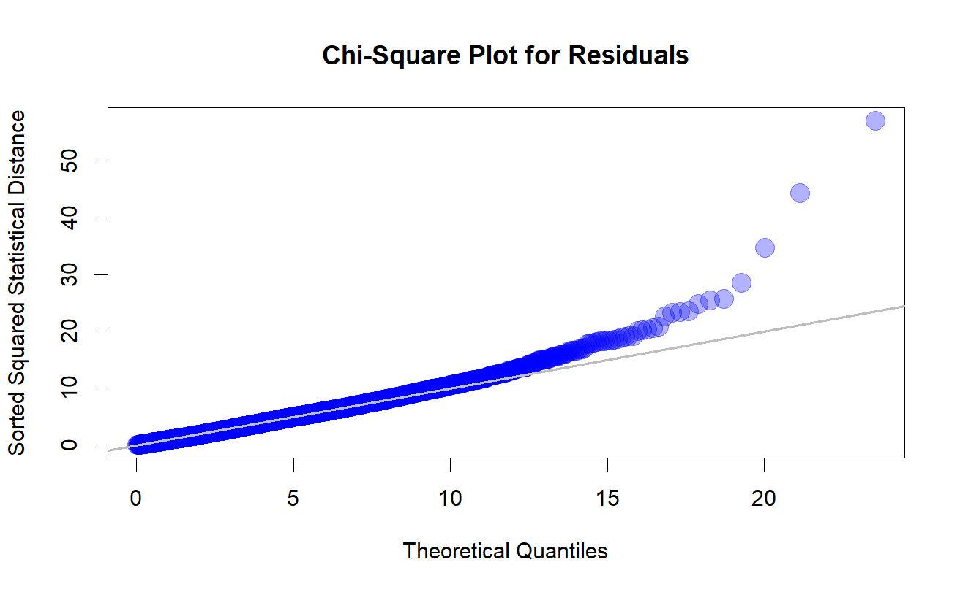

Slide 24
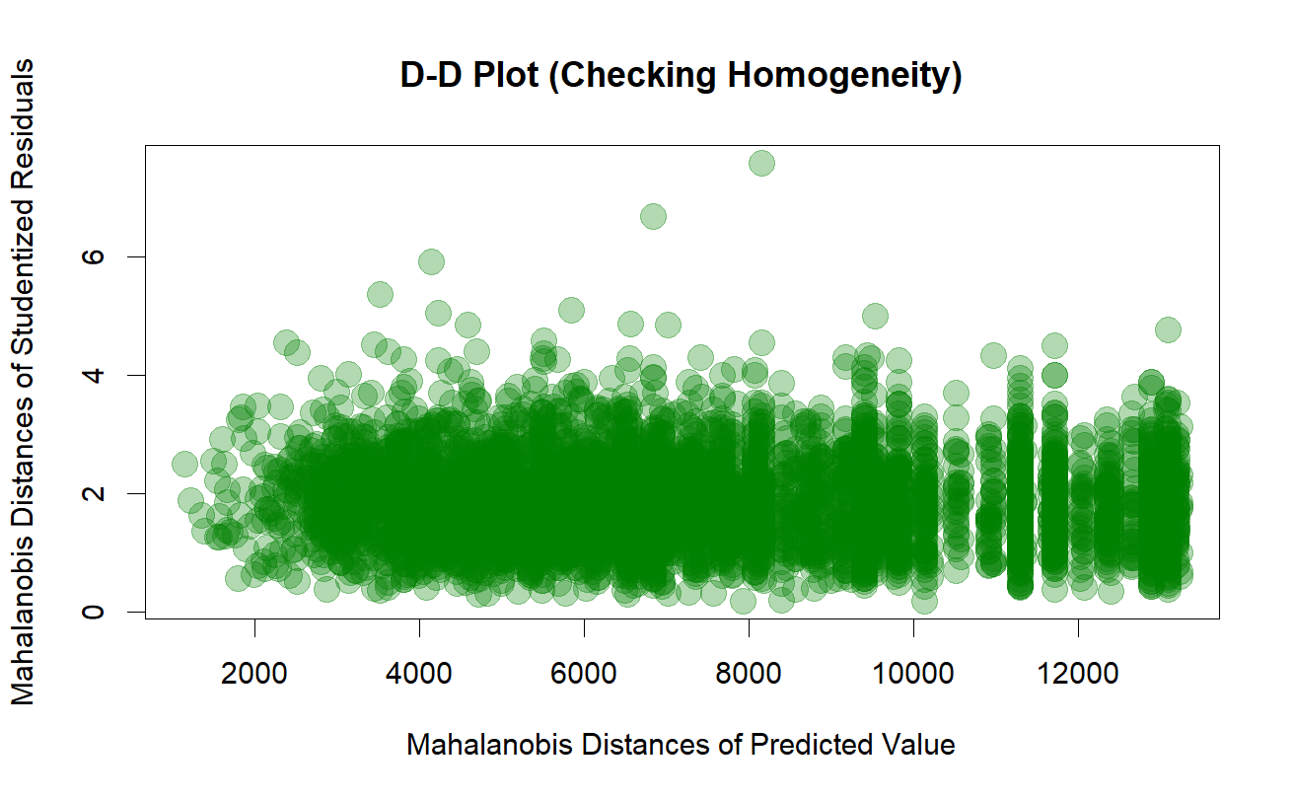
Notes:
Yuzhou stops here

Slide 25
Conclusion

Slide 26
Conclusion
Given the constraints of the dataset, such as missing information on how the data was originally collected, we built the most appropriate multivariate linear regression model possible.
Data does not follow a multivariate normal distribution, while the data does seem to have homogeneity.
This study found that BMI categories, particularly obesity and overweight, were significantly associated with higher systolic and diastolic blood pressure and higher glucose levels. Gender differences were evident in pulse rate, with males showing higher values. Additionally, hypertension status strongly influenced both systolic and diastolic blood pressure.
Age was a cofounder for the BMI and blood pressure, also it is a confounder of glucose level and BMI.

Slide 27
Limitations & Future Work

Slide 28
Limitations
Reliability of the dataset is poor. The specific methods employed for data collection—such as whether it was gathered through surveys, medical records, or other means—are not detailed in the dataset description.
We can not make causal inference.
Not many predictors to work with after using 4 continuous response variables.
We did look for outliers using Mahalanobis Distance threshold using an 95th percentile. Identified 303 outliers but we did not remove them since we were unsure how to verify whether they were influential data points.

Slide 29
Future Work
Either try to find a more reliable dataset with more variables.
We might think about decrease response variables number
  i.e. Instead of using Systolic Blood Pressure (SBP) and Diastolic Blood Pressure (DBP), we might try using Mean Arterial Pressure (MAP).
Try more Post-Hoc analysis to better understand the dataset.
Include multiple population / study centers to generalize the findings.
Figure out how to identify whether an outlier observation is influential enough to be removed from the analysis.

Slide 30
References
Prama, Tabia Tanzin, et al. DiaHealth: A Bangladeshi Dataset for Type 2 Diabetes Prediction. Mendeley Data, V1 (2024), https://doi.org/10.17632/7M7555VGRN.1.
Ramesh, Gautam et al. Associations Between Adherence to the Dietary Approaches To Stop Hypertension (Dash) Diet and Six Glucose Homeostasis Traits in the Microbiome and Insulin Longitudinal Evaluation Study (Miles). DigitalCommons@TMC. Print.
Li, Shengxu et al. “BMI and Waist Circumference Are Associated with Impaired Glucose Metabolism and Type 2 Diabetes in Normal Weight Chinese Adults.” Journal of diabetes and its complications 28.4 (2014): 470–476. Web.
Il’yasova, D et al. “Prospective Association between Fasting NEFA and Type 2 Diabetes: Impact of Post-Load Glucose.” Diabetologia 53.5 (2010): 866–874. Web.
Branch, OraLee H et al. “Relationships Between Blood Pressure Reduction, Weight Loss, and Engagement in a Digital App–Based Hypertension Care Program: Observational Study.” JMIR formative research 6.10 (2022): e38215–e38215. Web.
Ma, Jun et al. “Quantifying the Relationships of Blood Pressure with Weight, Height and Body Mass Index in Chinese Children and Adolescents.” Journal of paediatrics and child health 48.5 (2012): 413–418. Web.
DRIVSHOLM, T et al. “Symptoms, Signs and Complications in Newly Diagnosed Type 2 Diabetic Patients, and Their Relationship to Glycaemia, Blood Pressure and Weight.” Diabetologia 48.2 (2005): 210–214. Web.
Kahn, Linda G et al. “Evaluating the Relationship Between Birth Weight for Gestational Age and Adult Blood Pressure Using Participants From a Cohort of Same-Sex Siblings, Discordant on Birth Weight Percentile.” American journal of epidemiology 186.5 (2017): 550–554. Web.

